Slide 1


SAP S/4HANA Training
MASTER DATA GOVERNANCE (SAP MDG)
Neeraj Gupta
Session 28
SAP MDG – Consolidation & Mass Processing

Slide 2
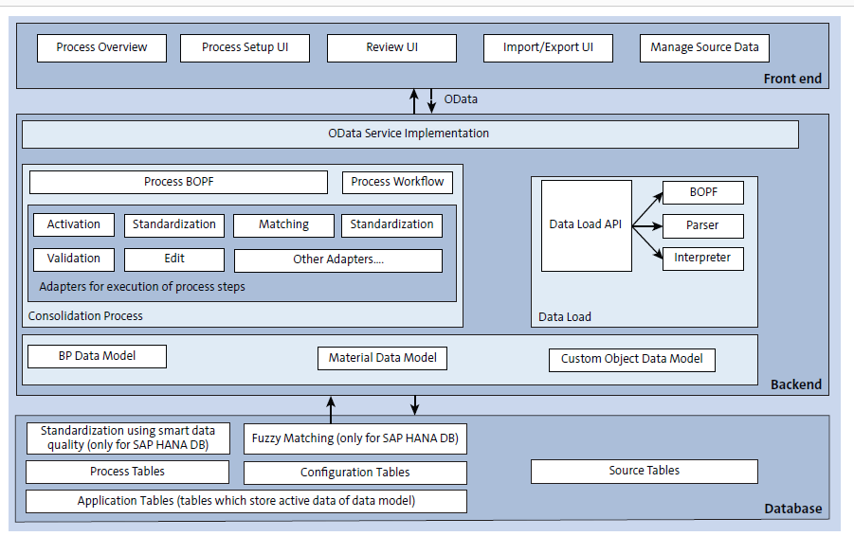
Architecture for Consolidation
28
SAP MDG – Consolidation and Mass Processing

Slide 3
FIORI APPs for Consolidation
28
SAP MDG – Consolidation and Mass Processing

Slide 4
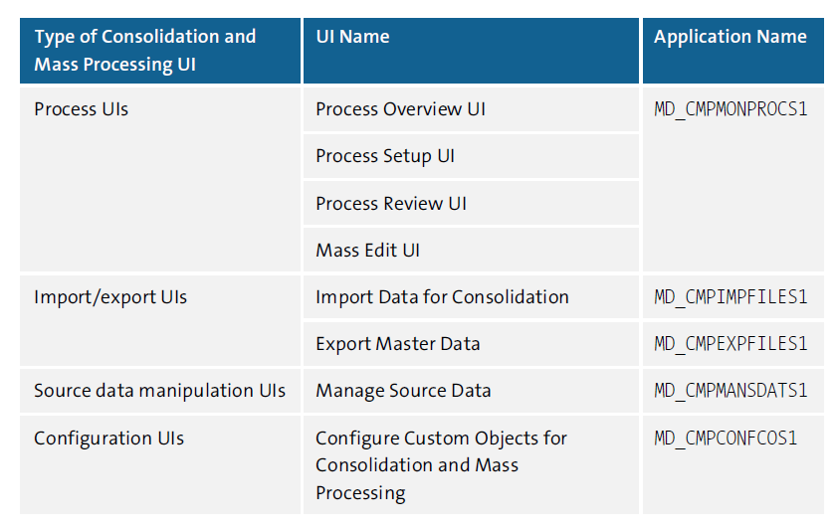
Standard UIs for Consolidation & Mass Processing
28
SAP MDG – Consolidation and Mass Processing

Slide 5
Master Data Semantic Object
28
SAP MDG – Consolidation and Mass Processing

Slide 6
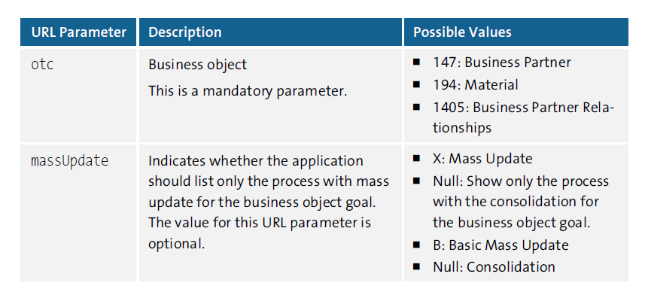
URL Parameters for Process Overview UIs
28
SAP MDG – Consolidation and Mass Processing

Slide 7
URL Parameters for Process Overview UIs
28
SAP MDG – Consolidation and Mass Processing

Slide 8
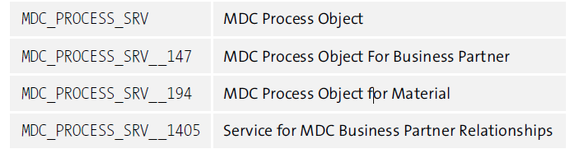
Odata Services for Business Objects
28
SAP MDG – Consolidation and Mass Processing

Slide 9
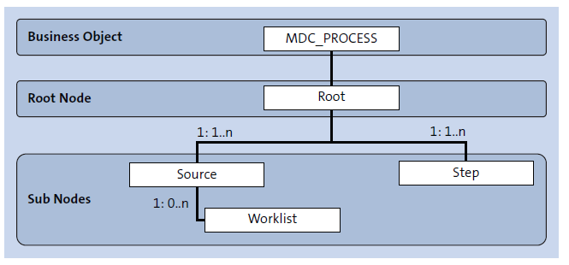
Business Object Model for MDC_PROCESS Object
28
SAP MDG – Consolidation and Mass Processing

Slide 10
Workflow Object Standard workflow template WS54500001
28
SAP MDG – Consolidation and Mass Processing

Slide 11
Adapter Classes
28
SAP MDG – Consolidation and Mass Processing

Slide 12

End of Session 28

Slide 13

Questions

Slide 14

Neeraj Gupta

Slide 15


We’re committed to empower you to be
Most Desirable Resource
through powerful training solutions.
We build the workforce of the future.
250+
Corporate Clients
30,000+
Learners Trained
25000+
Learners Placed
FREE WEBINARS
Sign up for free webinars with industry experts every fortnight!
Enroll Now!
Contact us today!
https://anubhavtrainings.com/

Slide 16




More from AnubhavTrainings.com

